Slide 1

Core JavaScript
CITS3403 and CITS5505 - Agile Web Development
Unit Coordinator: Matthew Daggitt
2024 Semester 1

Slide 2
What is JavaScript?
JavaScript is a high-level, dynamic, untyped, and interpreted programming language. It has been standardized in the ECMAScript language specification.
Alongside HTML and CSS, it is one of the three essential technologies of World Wide Web content production.
JavaScript is prototype-based with first-class functions, making it a multi-paradigm language, supporting object-oriented, imperative, and functional programming styles.
Language specification: http://www.ecmascript.org/
Tutorial: http://www.w3schools.com/js/
Components
Core JavaScript – the heart of the language.
Client-side JavaScript – objects supporting browser control and user interaction.
Server-side JavaScript – objects that support use in web server.

Slide 3
Uses of JavaScript
Provides an alternative to server-side programming:
Servers are often overloaded.
Client processing has quicker reaction time.
JavaScript can work with forms.
JavaScript can interact with the internal model of the web page to alter the page dynamically (see client-side JavaScript in the next lecture).
JavaScript is used to provide more complex user interface than plain forms with HTML/CSS can provide.
Linux in JavaScript? http://jslinux.org/

Slide 4
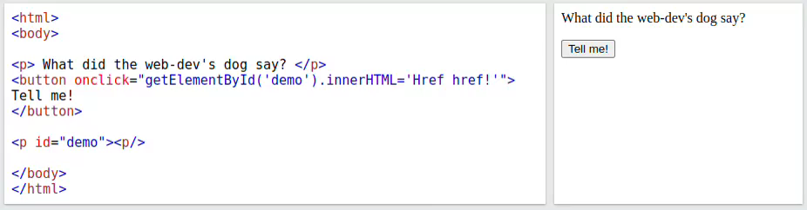
Event-driven computation
User's actions, such as mouse clicks and key presses, are referred to as events.
The main task of many JavaScript programs is to respond to events.
For example, a JavaScript program could validate data in a form before it is submitted to a server
Caution: It is important that crucial validation be done by the server. It is easy to bypass client-side controls
For example, a user might create a copy of a web page but remove all the validation code.

Slide 5
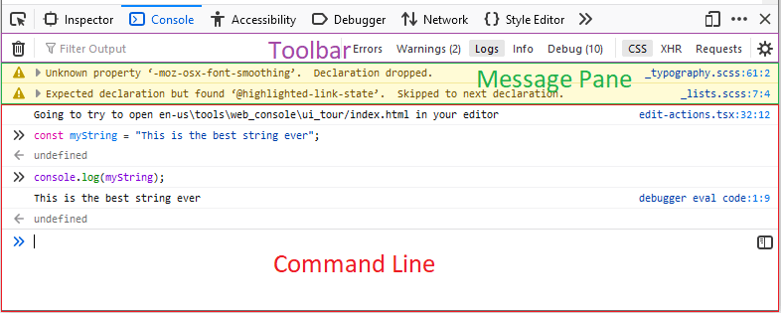
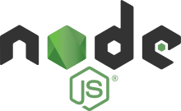
Executing JavaScript
There are two main execution environments for JavaScript:
The browser: every modern web browser can execute JavaScript, and many JavaScript functions refer explicitly to an HTML container or window. To test and execute JavaScript, you need an HTML file to call the JavaScript function, and a browser to open that file.
NodeJS: Node is a server-side JavaScript environment. This is useful since we can run the same code the client uses on the server. This is more like a tradition console environment you may have seen (e.g., Python). You can install Node on your local machine from https://nodejs.org/en/
We will only cover the first in this course as we will use Python for our server.

Slide 6
JavaScript in the browser
Notes:
6

Slide 7
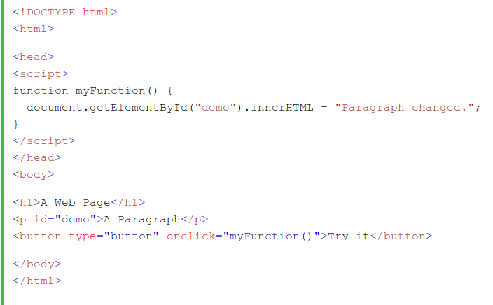
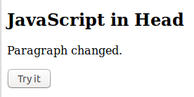
Including JavaScript in the Browser
There are several ways to include JavaScript in a web-page:
Inline in a tag attribute (e.g. onclick)
Included in the document in the body of a <script> tag.
From an external file referenced via a URL, using the src attribute of the <script> tag.

Slide 8
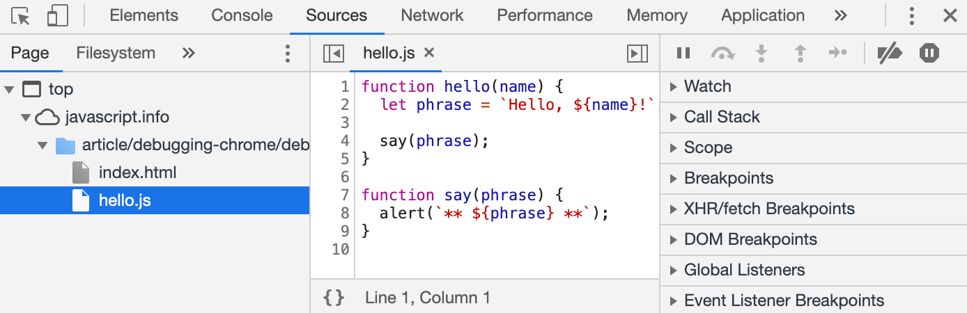
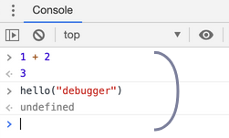
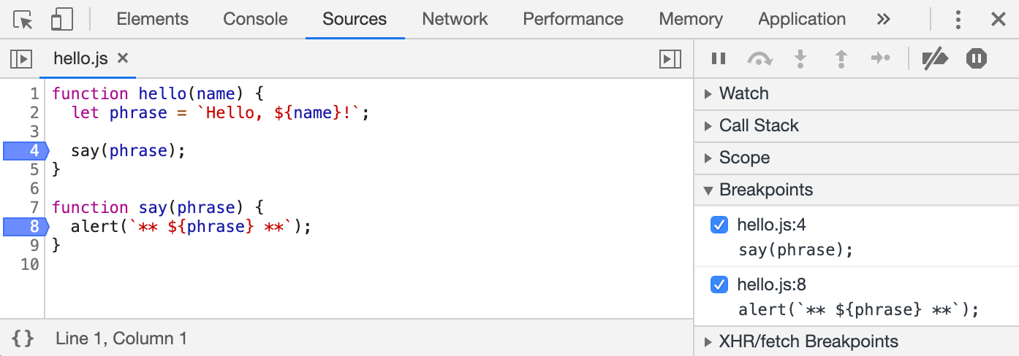
Debugging JavaScript in the browser
JavaScript errors are detected by the browser. We will look at Chrome, but other browsers offer similar functionality:
DevTools allows you to browse code.
Console allows you to interact with the code and the page.
Breakpoints and debugger allows you to interact with the code as it executes.
8

Slide 9
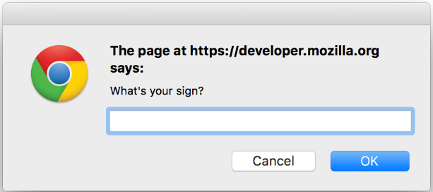
JavaScript IO
The standard output for JavaScript embedded in a browser is the window displaying the page in which the JavaScript is embedded.
Writing logs or error messages to the document object is now considered bad practice. For simple debugging use console.log.
To output information to the user, you can use alert or confirm.
To get input from the user, you can use the prompt function.
9
Notes:
9

Slide 10
Basics of Core JavaScript
Notes:
10

Slide 11
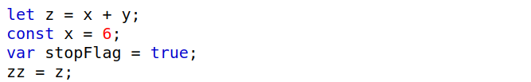
JavaScript variables
Variable names must start with a dollar `$` symbol, an underscore `_` symbol or any letter and they must continue with any number of dollar or underscore symbols, letters or digits. They are case sensitive and conventionally names are written in camelCase.
Variable assignment is performed using the standard `=` symbol
Variables are declared using the keywords let, const, var or nothing at all, e.g.
The differences in between these four types of variables will be discussed later, but a good rule of thumb is that you should always use let by default.
Multiple variables may be declared on the same line:

Slide 12
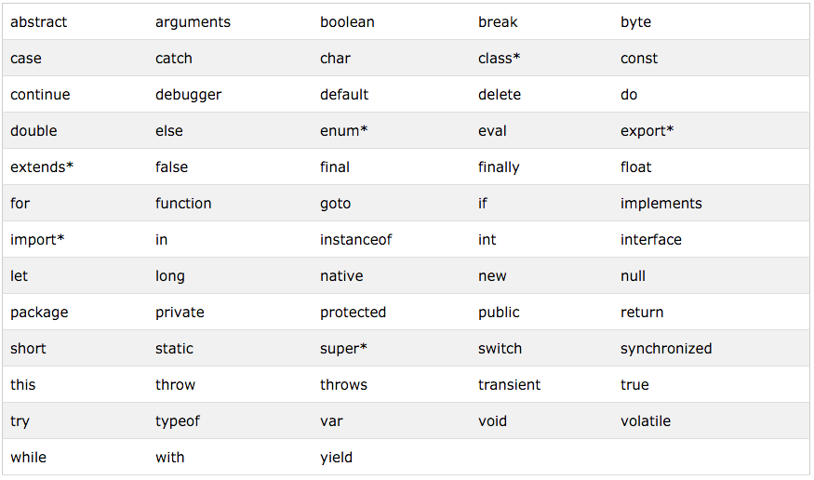
JavaScript keywords
Certain words are reserved and not allowed as variable names.

Slide 13


JavaScript syntax
Single line comments are written // and multi-line comments /* … */
Statements should be terminated with a semicolon ';' however the interpreter will insert the semicolon if missing and the statement seems to be complete.
This is because, like HTML, the JavaScript will tolerate incorrect code as much as possible.... and will just keep going!
Can be a big problem, e.g.
return
x;
becomes
return;
x;

Slide 14
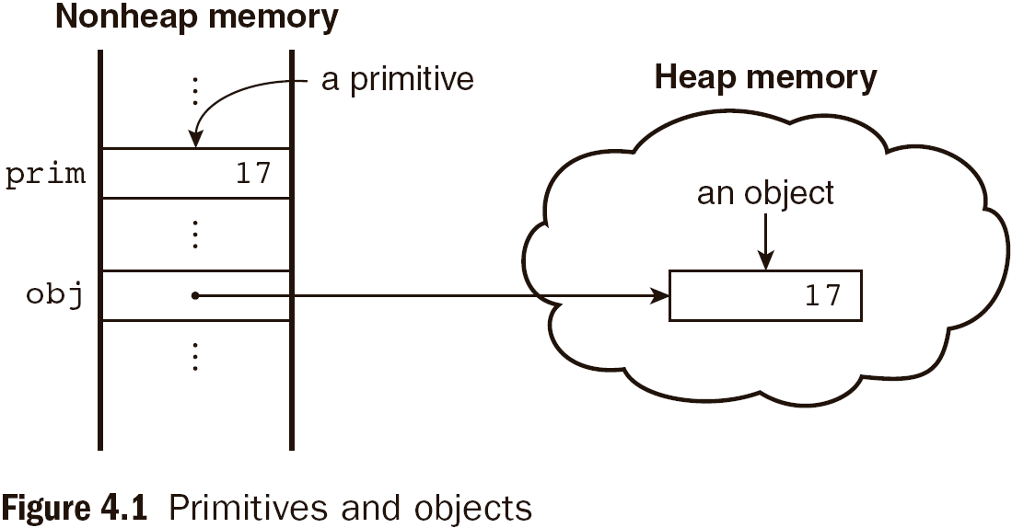
JavaScript primitives and objects
JavaScript primitive data types: Number, String, Boolean, null, undefined
Some common JavaScript object datatypes: Function, Array, Date, Math, etc.
Object properties (either data or methods) are referred to using the standard dot `.` syntax, e.g.
"abc".length Math.sin(…)
Objects are automatically garbage collected when there no longer exist any references to them.

Slide 15
Numbers in JavaScript
All Number values are represented internally as double-precision floating-point.
According to the JavaScript language specification, they are all double-precision 64-bit format IEEE 754 values. As always, you must be a little careful with arithmetic:
0.1 + 0.2 = 0.30000000000000004
Standard arithmetic operators available: +, *, -, /, %, etc.
Increment and decrement operators: --, ++
Compound assignment operators: += -= /= *= %= etc.
a += 7 means the same as a = a + 7

Slide 16
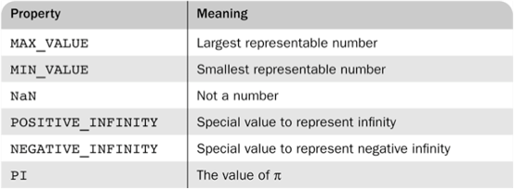
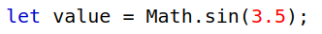
Numbers in JavaScript
The Number object in JavaScript has constants for various special values:
e.g. Number.POSITIVE_INFINITY
For advanced mathematical operations you can use the built-in Math object
You can convert a string to an integer by using the parseInt function:

Slide 17
When is a number not a number?
Invalid operations return a special value NaN - "Not a number".
For example, NaN is returned for a non-numeric argument to parseInt:
NaN is infectious – if it is an input to any mathematical operation, the result will also be NaN:
You can check for NaN by using the built-in isNaN function:

Slide 18
Strings in JavaScript
All String values in JavaScript are sequence of Unicode characters, where each character is represented by a 16-bit number.
This is a very good news to anyone who must deal with internationalization as they can represent characters in any alphabet.
A String literal is delimited by either single or double quotes
There is no difference between single and double quotes.
Certain characters may be escaped in strings
\’ or \” to use a quote in a string delimited by the same quotes
\\ to use a literal backslash
\n = new line, \t = tab
The empty string ‘’ or “” has no characters
JavaScript doesn’t have any Character data-type. So, if you want to represent a single character, you need to use a string of length 1.
Notes:
18

Slide 19
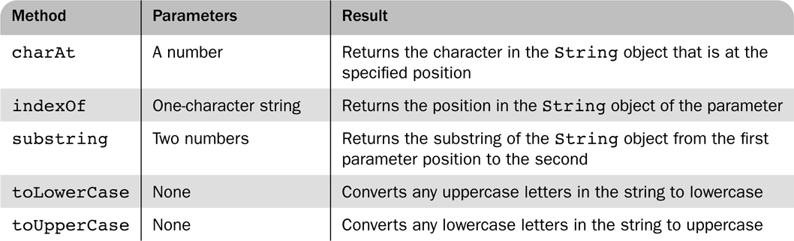
Manipulating Strings
Character positions in strings begin at index 0.
One property length which returns the number of characters in the string and several methods on String objects:
The toString method converts a number to string.
You can use `+` to concatenate two strings and you can also use it to convert a string to a number
let value = + “123”;

Slide 20
Booleans in JavaScript
JavaScript has a Boolean type, with possible values of true and false.
Basic Boolean operators
Logical not: !
Logical and: &&
Logical or: ||
The && and || operators short-circuit, which means whether they will evaluate their second operand depends on the result of the first.

Slide 21
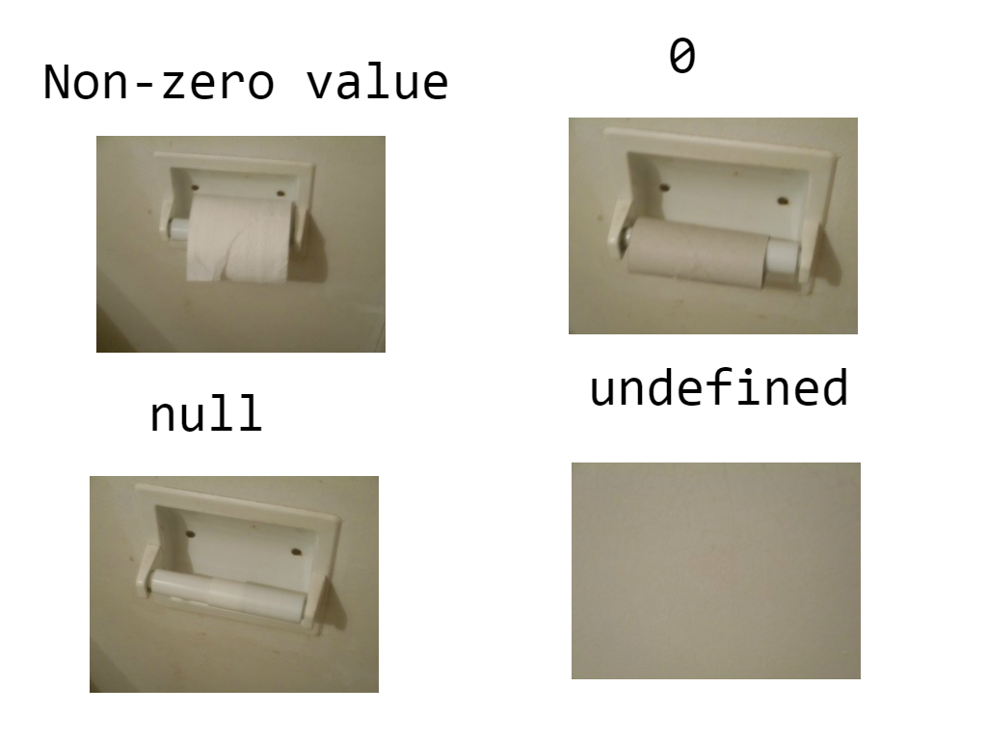
Null and Undefined
JavaScript is relatively unusual as it has two different ways to indicate that a variable does not have a value assigned to it.
Null: a variable that is intentionally not assigned a value has a null value
Undefined: the value of a variable that is not declared or not assigned

Slide 22
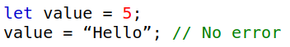
JavaScript typing
In JavaScript is dynamically typed, and so variables have no assigned types.
A variable can therefore hold different types of values at different times during program execution.
The typeOf function returns the current type of its argument
returns “number” or “string” or “boolean” for primitive types
returns “object” for an object or null
returns "function" for functions
returns "undefined" for uninitialised variables

Slide 23
JavaScript implicit type conversion
JavaScript attempts to convert values to be able to perform operations
When a Number is expected:
true and false are converted to 1 and 0, e.g. 4 - true // = 3
Strings are converted to their value or NaN, e.g. 7 * “3” // = 21
null is converted to 0
undefined is converted to NaN
When a String is expected:
Numbers are converted to their string value, e.g. 1 -> "1"
Booleans are converted to "true" and "false"
null is converted to "null"
undefined is converted "undefined"

Slide 24
JavaScript implicit type conversion
When a Boolean is expected:
0 is goes to false, all other numbers are interpreted as true
The empty string is interpreted as false,
All other strings (including “0”!) as true
Undefined, NaN and null are all interpreted as Boolean false
This behaviour is useful for;
checking for null objects before accessing their attributes:
Or for setting their default values:
All these conversions can be applied manually be calling the functions Number(...), String(...), Boolean(...) on the argument to be coerced.

Slide 25
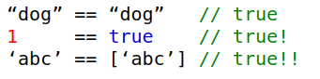
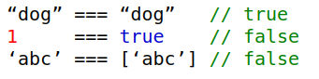
JavaScript comparisons
The comparison operators in JavaScript (>, <, >=, <=, ==, ===, !=, !==) work for both strings and numbers.
The == operator performs type coercion if you give it arguments of different types
The === operator performs returns true only if both operands are equal, and of the same type.
Use `===` by default unless you have a good reason not to.

Slide 26
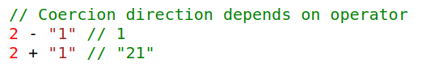
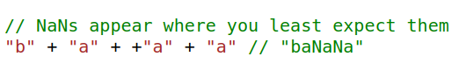
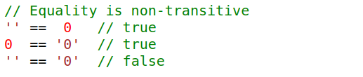
Type conversion craziness time
Type coercion leads to some incredibly unintuitive results

Slide 27
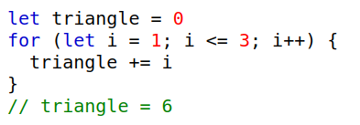
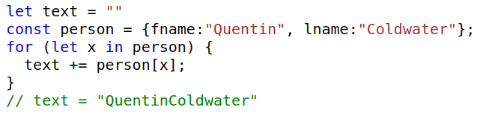
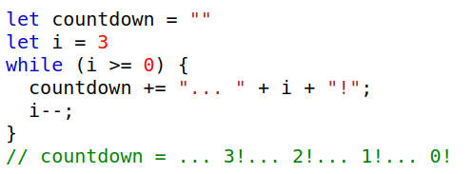
JavaScript control structures - loops
JavaScript has standard for, for in and while loops.

Slide 28
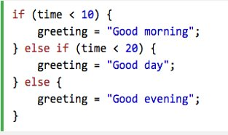
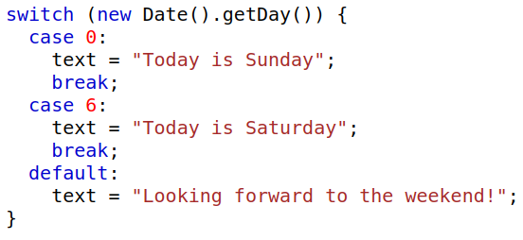
JavaScript control structures - conditions
The if-then and if-then-else and switch statements are like that in other common programming languages, e.g. C/C++/Java
It also has ternary operator:

Slide 29
Arrays
Notes:
29

Slide 30
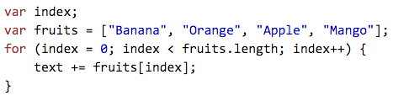
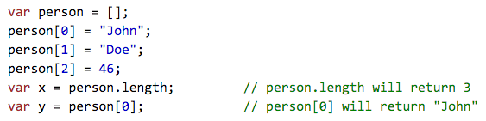
Array basics
Arrays are lists of elements indexed by a numerical value.
Array indices in begin at 0 and an array's length is one more than the highest index.
The size of an array can be modified even after they have been created
Elements of an array do not have to be of the same type!
New arrays can be created using square bracket notation:
30

Slide 31
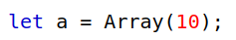
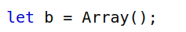
The Array() constructor method
Arrays can be created using the Array() method
Passing 1 numeric parameter creates an empty array of the specified number of elements:
Length of the array is 10.
Only assigned elements of an array occupy memory, i.e. if only elements 2 through 4 were assigned values, the other 7 elements would not be allocated storage and would remain undefined.
Passing no parameters creates an empty array of length 0:
Passing either one non-numeric parameter or two or more parameters, or creates an array with the specified parameters as elements:
Length of the array is 4 with the four provided elements in them.
31

Slide 32
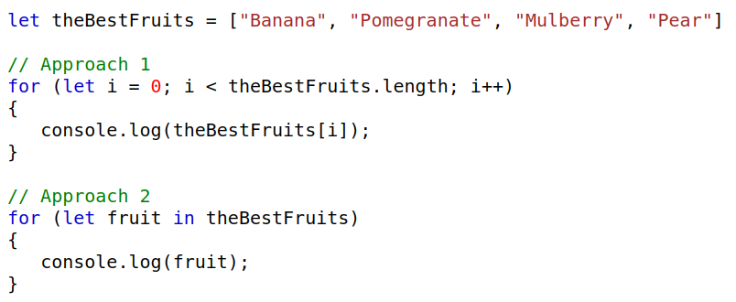
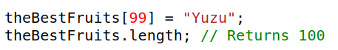
Accessing array elements
You can iterate over an array using the length property, or a for in loop
Assignment to an index greater than or equal to the current length simply increases the length of the array:
Querying a non-existent array index, returns undefined:
Errors go undetected!
32

Slide 33
Array methods
Method | Description
push | Add an element to the end
pop | Remove an element from the end
shift | Remove an element from the front
unshift | Add an element to the front
join | returns a string of the elements in the array
reverse | reverses the array
sort | sorts the array, accepts optional comparator function
concat | concatenates 2 or more arrays
slice | creates 2 arrays from 1 array
splice | inserts a group of elements at a given index
delete | replaces an element at an index with undefined
33

Slide 34
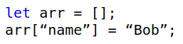
Associative arrays
Associative arrays uses String values instead of Number values as indices:
They act somewhat like ordinary arrays, but the following operations are not available to them:
push, pop, shift, unshift
We won't discuss them much here as they are really Objects under the hood which will be covered later on.
34

Slide 35
Functions
Notes:
35

Slide 36
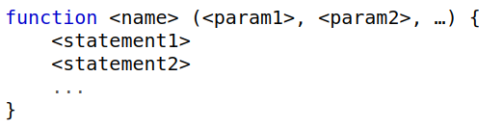
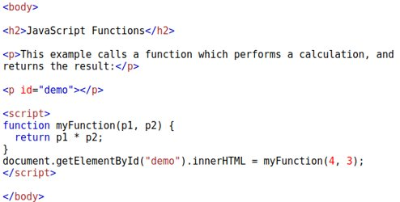
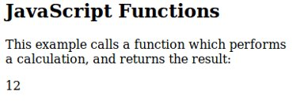
Defining a JavaScript function
Syntax for defining a function:
Functions must be defined before use (i.e. in a page header, or in an external file)
36

Slide 37
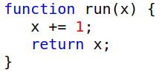
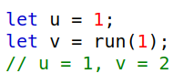
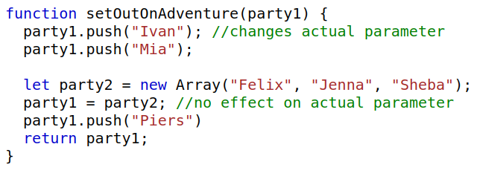
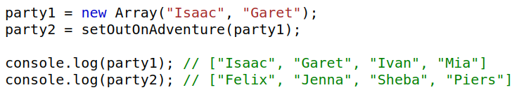
Calling a JavaScript function
Primitive parameters are passed using call by value:
Object parameters are passed using call by sharing, i.e. the reference is passed, so the function body can change the object however, an assignment to the parameter within the function will not change the original parameter
37

Slide 38
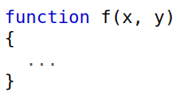
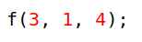
Function parameters
JavaScript is very lax about function parameters:
Like Python, parameters have no type specified
You can pass too few in which case the missing arguments are undefined.
You can pass too many in which case they are not addressable by name.
Parameters named in the function definition are called formal parameters.
Parameters provided in a function call are called actual parameters.

Slide 39
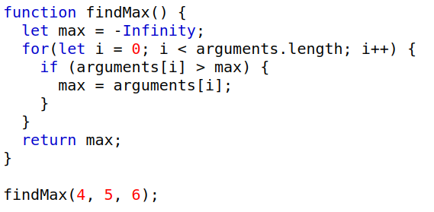
Actual function parameters
This flexibility is typical of many scripting languages: different numbers of parameters may be appropriate for different uses of the function.
A property array named arguments holds all the actual parameters, including the extra ones not specified in the definition.
39

Slide 40
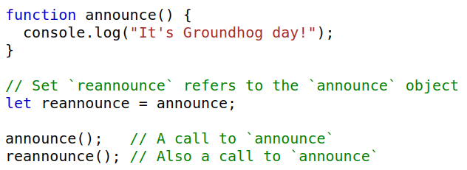
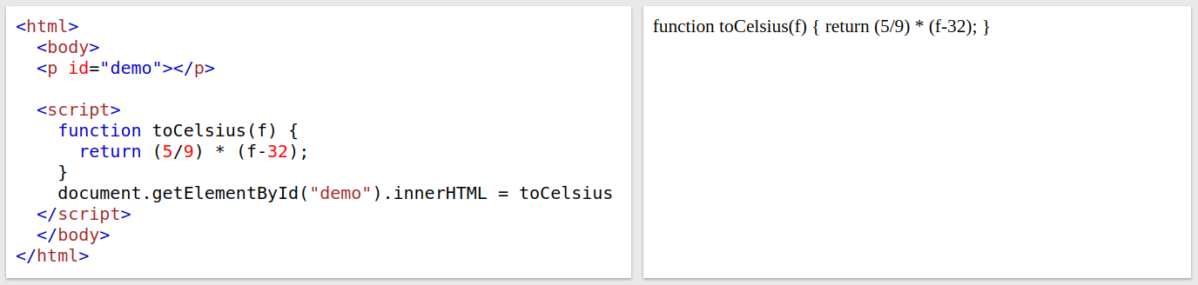
Functions are first-class
Functions are first-class objects in JavaScript, so accessing a function without appending () will return the function definition instead of calling it.
Therefore, functions may be assigned to variables and to object properties:
When cast to a String a function is converted to its definition as text:
40

Slide 41
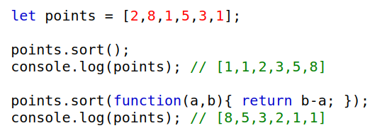
Anonymous functions
You can also write anonymous functions (i.e. functions without a name).
For example, consider the sort function on arrays, which accepts a parameter to specify the order in which to sort the elements. The parameter is a function that takes two parameters and returns:
a negative value if the first parameter comes before the second
a positive value if the first parameter comes after the second
0 if the first parameter and the second parameter are equivalent
Anonymous functions can be written more concisely using (...)=> syntax, e.g.

Slide 42
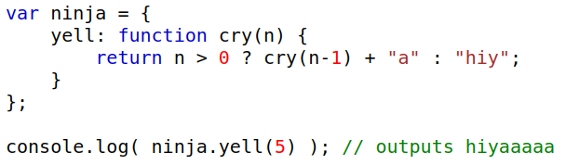
Recursive functions
Like any other languages, you can write recursive functions in JavaScript.
However, this creates a problem if the function is anonymous. How would you call a function without its name? The solution is using named anonymous functions:

Slide 43
Objects
Notes:
43

Slide 44
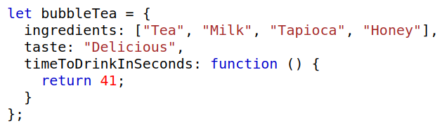
Objects are name-value pairs
JavaScript objects are essentially collections of name-value pairs where:​
the names are JavaScript strings​
the values can be any JavaScript value – including more objects. ​
Similar to:​
HashMap<String, Object> in Java. ​
Dict in Python​
Quickest way to create a new object is with { … } notation:
If a variable is not a primitive (undefined, null, Boolean, Number, String), it's an object. (i.e. arrays and functions are also just objects).

Slide 45
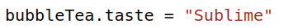


Revisiting object properties
Previously we've seen an object’s properties can be accessed using the dot operator:
However, they can also be accessed using array-like notation:
Both approaches are semantically equivalent however, because the second method provides the name of the property as a string, it has the following advantages:
the name can be calculated at run-time.
can be used to set and get properties with names that are reserved words.
The name method is used to refer to functions that are properties of objects.
As functions are first class objects, you can also update methods at runtime.

Slide 46



Revisiting object properties
Because objects are just a fancy list of name-value pairs you can:
Add new properties to an object:
Delete properties from an object:
Iterate through an object's properties:
attacker: Cloud
tank: Barret
46

Slide 47

The global object
In JavaScript there exists the global object which is available everywhere.
In the browser the name of this object is window but a more portable name is globalThis which works in any environment.
Can be used to add global variables to your program, but as always it is better to use global variables sparingly....
47

Slide 48


The this keyword
The keyword this refers to the current object. What that means is specified by the way in which you called that function.
For example:

Slide 49


Constructors
Constructor functions are functions that create and initialize properties for objects.
A constructor function uses this to reference the object being initialized.
The new keyword creates a brand-new empty object, and then calls the constructor function specified, with this set to that new object.
Every time we are creating a Drink object, we are creating a new brand-new function object within it that takes up memory. Wouldn’t it be better if this code was shared?
49

Slide 50
OOP in JavaScript
JavaScript's main approach to object-oriented code doesn’t use subtyping and polymorphism found in other popular OOP languages like Java, C# etc.
Instead, it supports a variation known as Prototype-based programming.
See, for example this Wikipedia article for a discussion: http://en.wikipedia.org/wiki/Prototype-based_languages
In prototype-based programming, classes are not present, and behavior reuse is accomplished through a process of decorating existing objects which serves as prototypes.
This model is also known as class-less, prototype-oriented or instance-based programming.

Slide 51


Reusing functions
The first way is to declare the function beforehand:
The second (and best) way is to add it to the prototype for the Drink object:

Slide 52

Prototypes
Drink.prototype is an object shared by all instances of Drink.
It forms a part of a lookup chain (or, prototype chain): any time you attempt to access a property of Drink that isn’t set, JavaScript will check Drink.prototype to see if that property exists there instead.
As a result, anything assigned to Drink.prototype becomes available to all instances of that constructor via this.
The root of the prototype chain is Object.prototype.

Slide 53

Add methods at runtime
Prototypes are an incredibly powerful tool. JavaScript lets you modify something’s prototype at any time in your program, which means you can add extra methods to all instances of an object at runtime:
JavaScript can also use prototypes to implement inheritance. A subclass can be defined to have the prototype of a superclass, and then the implementation of the methods can be overwritten in the subclass prototype...

Slide 54
The new keyword revisited
When the code new Drink(…)is executed, the following things happen:
A new object is created, with its prototype set to Drink.prototype.
The constructor function Drink is called with the specified arguments, and this is bound to the newly created object.
new Drink is equivalent to new Drink(), i.e. if no argument list is specified, the Drink constructor is called without arguments.
The object returned by the constructor function becomes the result of the whole new expression.
If the constructor function doesn't explicitly return an object, the object created in step 1 is used instead. (Normally constructors don't return a value, but they can choose to do so if they want to override the normal object creation process.)

Slide 55
Variable scoping and closures
Notes:
56

Slide 56

JavaScript scoping
The scope of a variable is the range of statements over which it is visible.
There are three different types of scope:
Global scope – accessible anywhere within the document
Function scope – accessible anywhere within the function
Block scope – accessible anywhere within the current block
Statements are grouped into the blocks delimited by braces: { ... }
A block is considered to contain code inside any smaller blocks inside of it.
56

Slide 57

JavaScript variable declarations
Remember how there were 4 (!) different ways to declare a variable in JavaScript?
const
let
var
undeclared

Slide 58

Const and let variables
Variables declared using const or let have block-level scope:
This is a good thing!
Variables can't interfere with other variables outside of the block.
When reasoning about its value, only need to consider the block.
The difference between const and let is that let variables can be set to a new value within the block whereas value of const variables can never be changed from the original declared value.
Therefore, use const where you can...
A variable declared with var outside a function definition has global scope​.
A variable declared with var inside a function definition has function scope, visible only inside the function definition​
If a global variable has the same name, it is hidden inside the function definition​
A variable declared with let or const has block level scope.​
58

Slide 59

Var variables
A variable declared with var inside a function definition has function scope, and is visible only inside the function definition​
This is not great...
Variables can interfere with other variables outside the block
When reasoning about its value, need to consider the whole function.
Can always be avoided:
If you don’t want to use x outside of the current block, leave it where it is and change it to a const/let
If you do want to use x outside of the current block, declare it as a const/let before the if block begins.
59

Slide 60

Undeclared variable scoping
A variable not previously declared always has global scope, and is visible throughout the page, even if used inside a function definition
This is a bad coding style!
May interfere with other variables anywhere in the document.
When reasoning about its value, need to consider the whole function.
60

Slide 61

Global variables
Variables declared within a block can be accessed by any child blocks within that block
Therefore, variables declared outside of functions are accessible within any subsequently declared function, regardless of if they use let/const/var.
However, only var variables are added to the global object.
61

Slide 62

Inner functions
JavaScript function declarations are allowed inside other functions:
Inner functions allow us to use one of the most powerful abstractions JavaScript has to offer: "closures"
A closure is the local variables for a function – kept alive after the function has returned.

Slide 63

Closures
A quick quiz, what does this do?
Here, the outer makeAdder function has returned, and hence common sense would seem to dictate that its local variable no longer exist. But they do still exist, otherwise the adder function would be unable to work.
Whenever JavaScript executes a function, a scope object is created to hold the local variables created within that function. It is initialised with any variables passed in as function parameters.

Slide 64

Closures
Closures are similar to the global object that all global variables and functions live in, but with a couple of important differences:
a brand-new scope object is created every time a function starts executing,
these scope objects cannot be directly accessed from your code.
So, when makeAdder is called, a scope object is created with one property: a, which is the argument passed to the function. It then returns a newly created function.
Normally JavaScript's garbage collector would clean up the scope object created for makeAdder at this point, but the returned function maintains a reference to that scope object. As a result, the scope object will not be garbage collected until there are no more references to the function object that makeAdder returned.

